Slide 1

EasyWay
Subject: CS691
Computer Science Project 1
Prof. Henry Wong

Slide 2

Agenda
The objective of this meeting is to understand how we’re tracking towards our deadlines, align on progress, address roadblocks, and sync on the next steps as they pertain to develop.
Discussion on timely submission. Marking the important dates. Add dates to a shared calendar
Discussion on presentation topics and iterative updating the presentation.
Confirm client requirements i.e., Think and study through personas, all the things that would be needed in our project from client’s point of view.
Discuss the risks.
Interaction, attendance, co-operation, teamwork, attention from each team member is needed to make the project success.

Slide 3
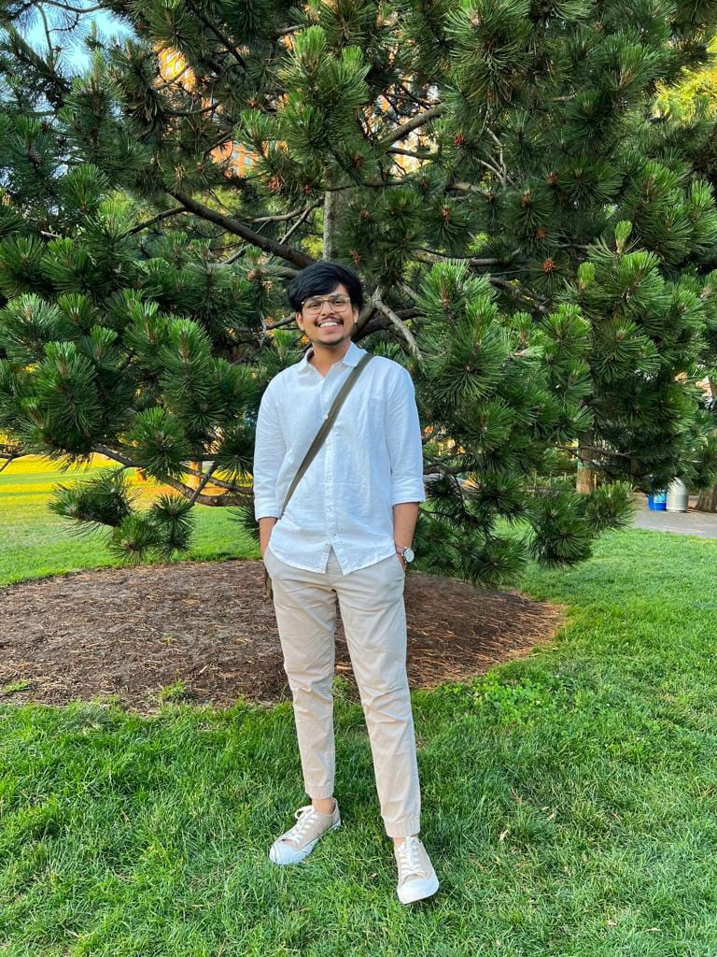

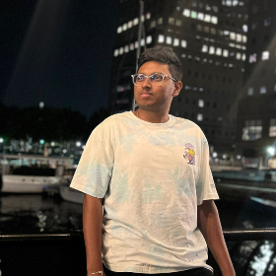
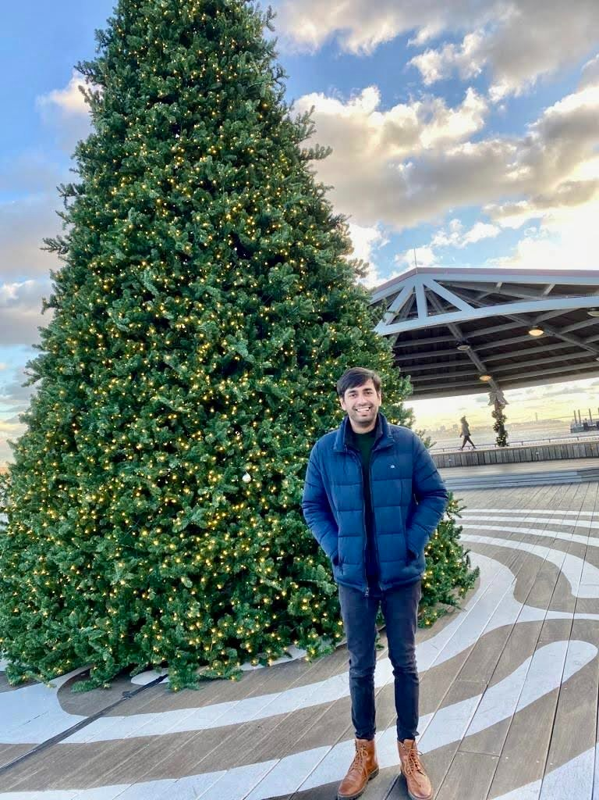
Team Member Roles
Shubham Sawant
Business Analyst & Developer
Aditya Kadarla
Project Manager
Quality Analyst & Tester
Ravi Kumar Dabbada
Database Administrator
Kshitij Sharma
Developer

Slide 4
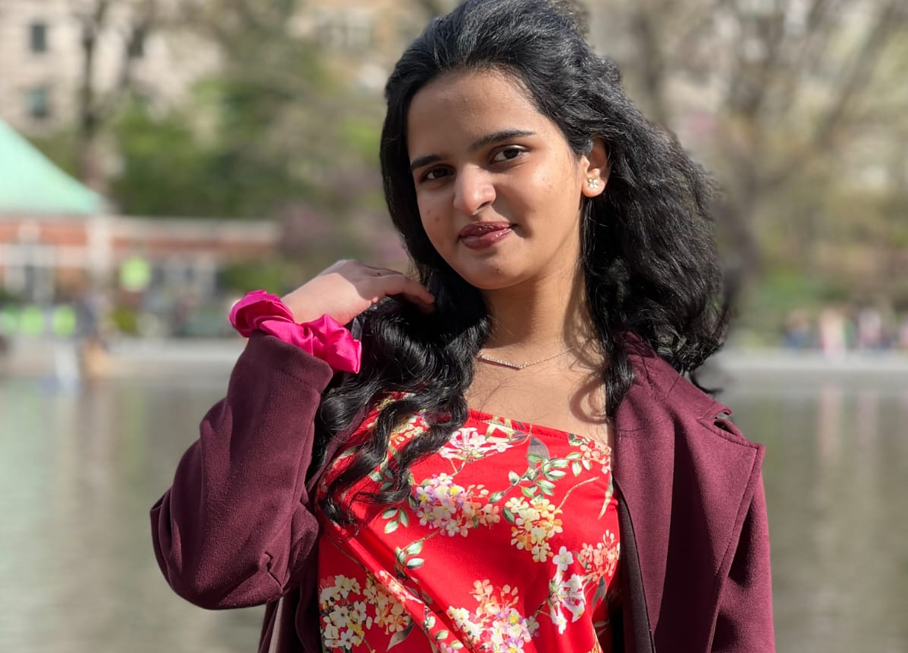
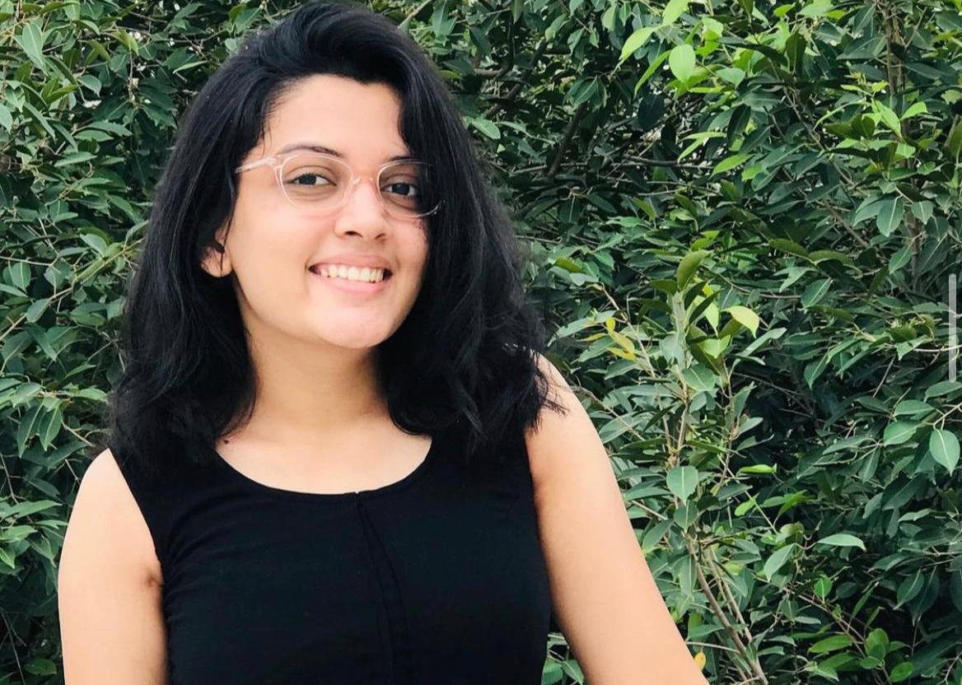
Team Member Roles
Vidisha Vijay Sawant
Developer
Femina Baldha
Developer

Slide 5

Improvements made from Professor's Feedback
Post the deliverable 1 presentation, we received feedback from the professor on changing the personas and making few changes in our sprint schedule which we did accordingly which can be seen in the further slides.

Slide 6

Problem Statement
Home services are an age-old concept. The “old way” of availing local home services was for servicemen (“handymen”) to market themselves through word of mouth, and then to use listing services such as Yelp. Local home services are inherently disorganized, with individuals usually running business operations. Services range from carpentry, plumbing, beauty, laundry, and so on. Think of anything you need in your home, that can’t be solved by buying a product. That is likely going to be solved by home services.
The trouble is, home services are not a commodity.
The core reason why people continued to rely on word of mouth after bad experiences, was because it was impossible to tell what you were getting into, even for something as “basic” as plumbing. How do you know the carpenter is good, or the plumber will do a good job? Sure, the industry is ripe for disruption, but how would it get disrupted?

Slide 7

Project description
The “EasyWay" web application aims to aggregate utility services such as beauty, electrical maintenance, home cleaning, pest control, etc. The application would enable the end-user to select their preferred service, book an appointment at a convenient time, pay the resultant charge and give feedback. The application aims to be a one-stop shop that caters to all the utility needs of the end user. Our product promises easy booking and cancellation without extra changes and you can maintain your booked services in one place easily.

Slide 8

personas

Slide 9
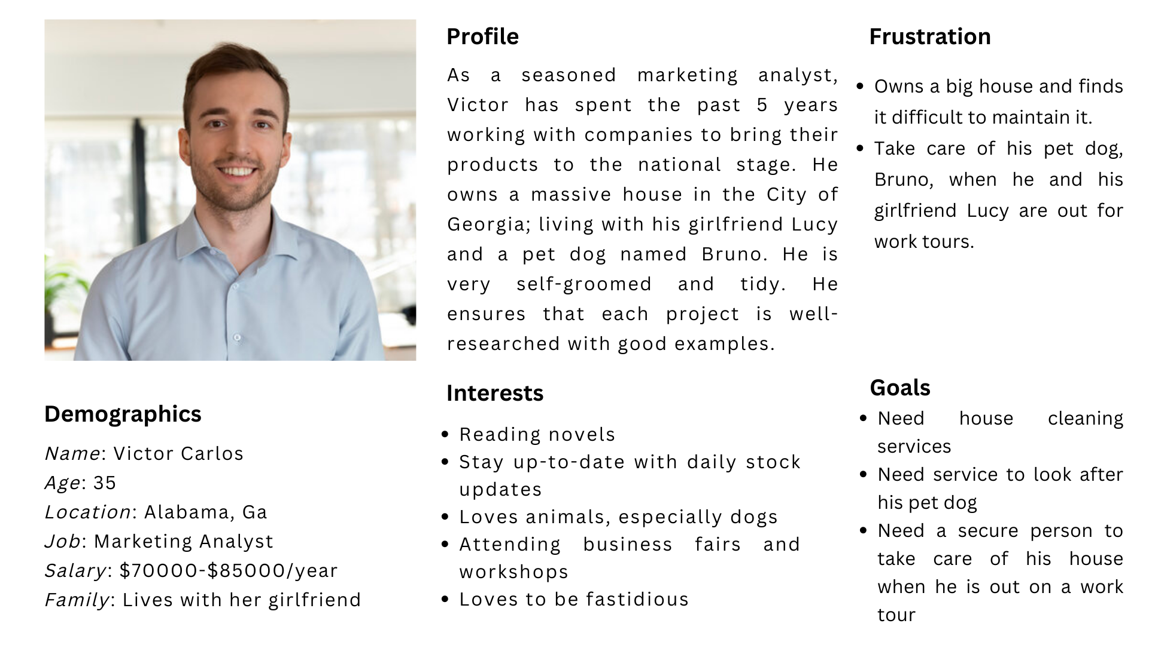
Persona 1

Slide 10
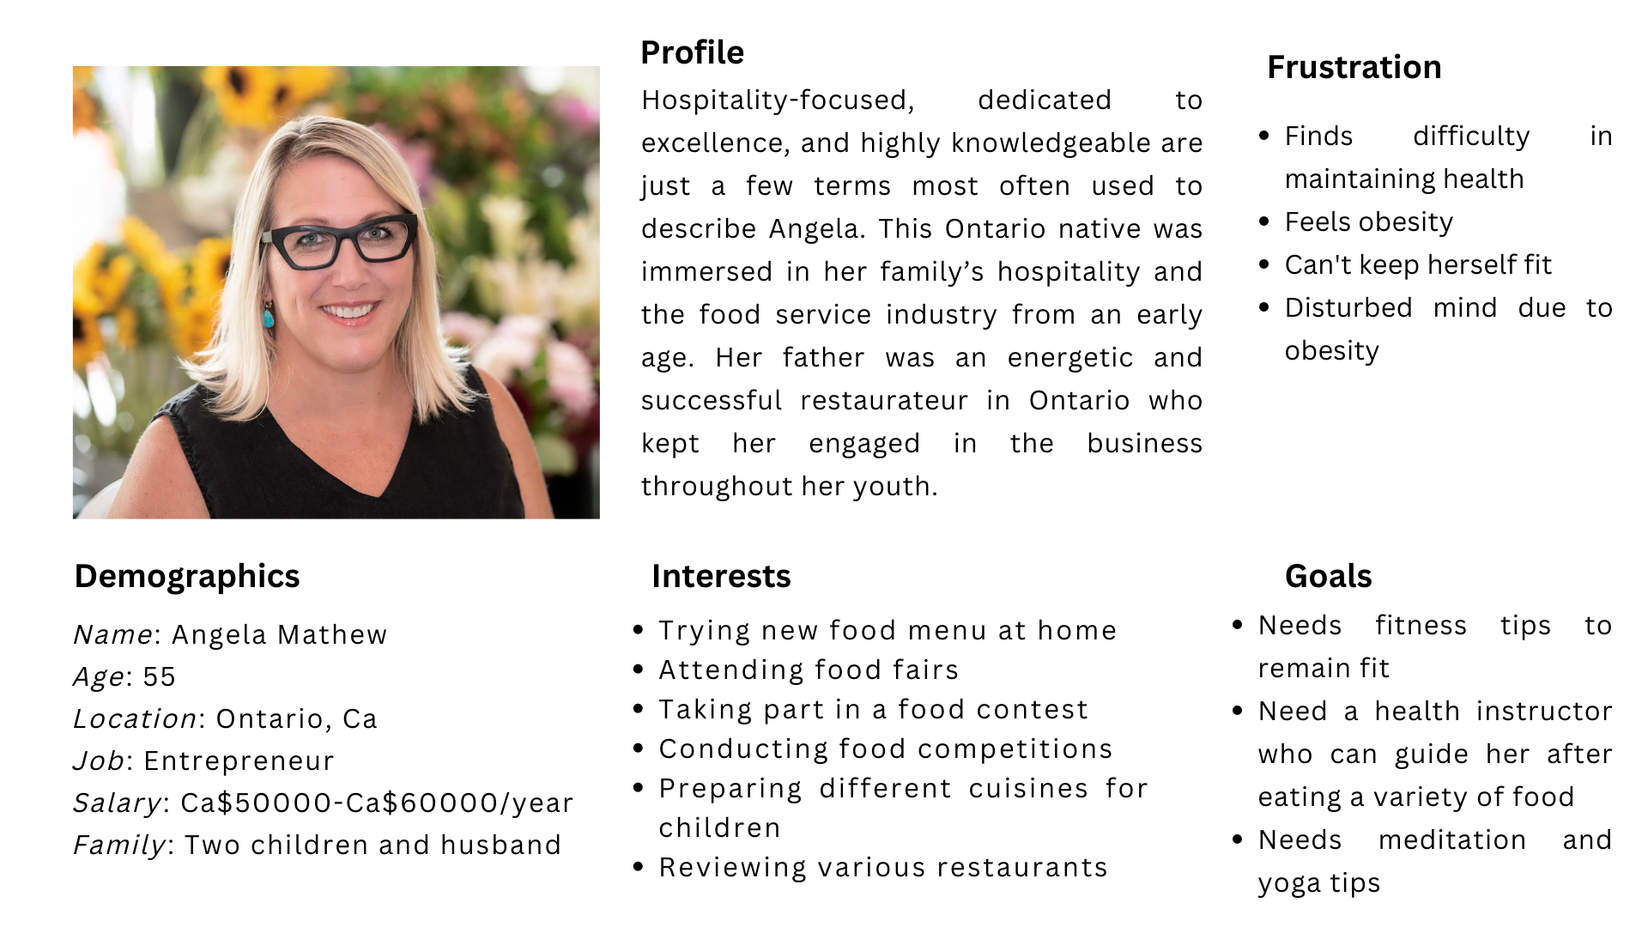
Persona 2

Slide 11
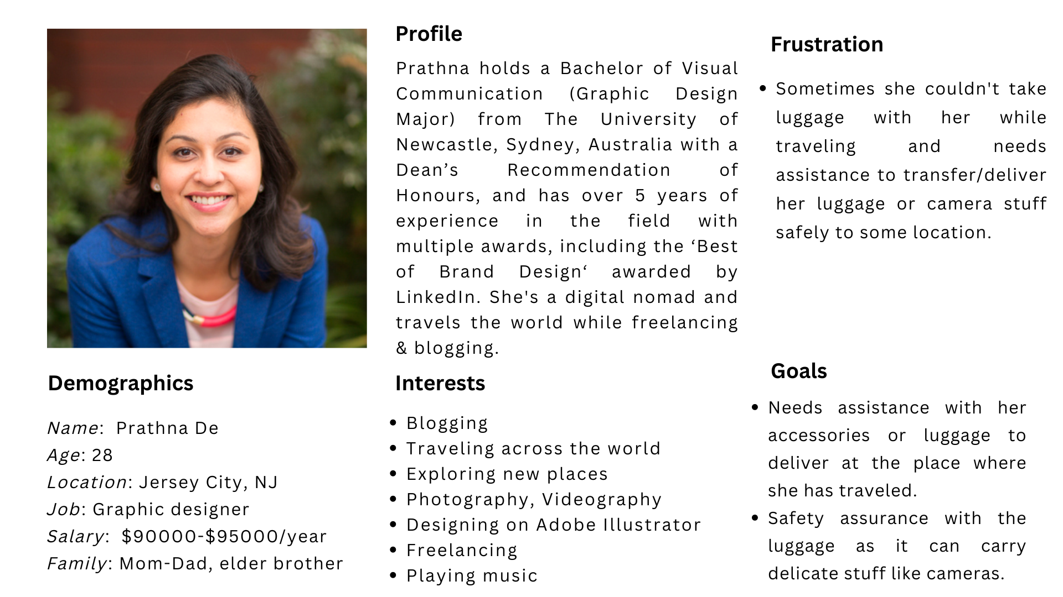
Persona 3

Slide 12

Minimal Viable Product (MVP)

Slide 13
Minimal Viable Product (MVP)
The following are the features that we are covering in our MVP:
Homepage
Services Catalog
Professional List in each service category
Registration - Customer and Professional
Login - Customer and Professional
Book - Calendar, and Time
Booking Confirmation via email or in-app

Slide 14
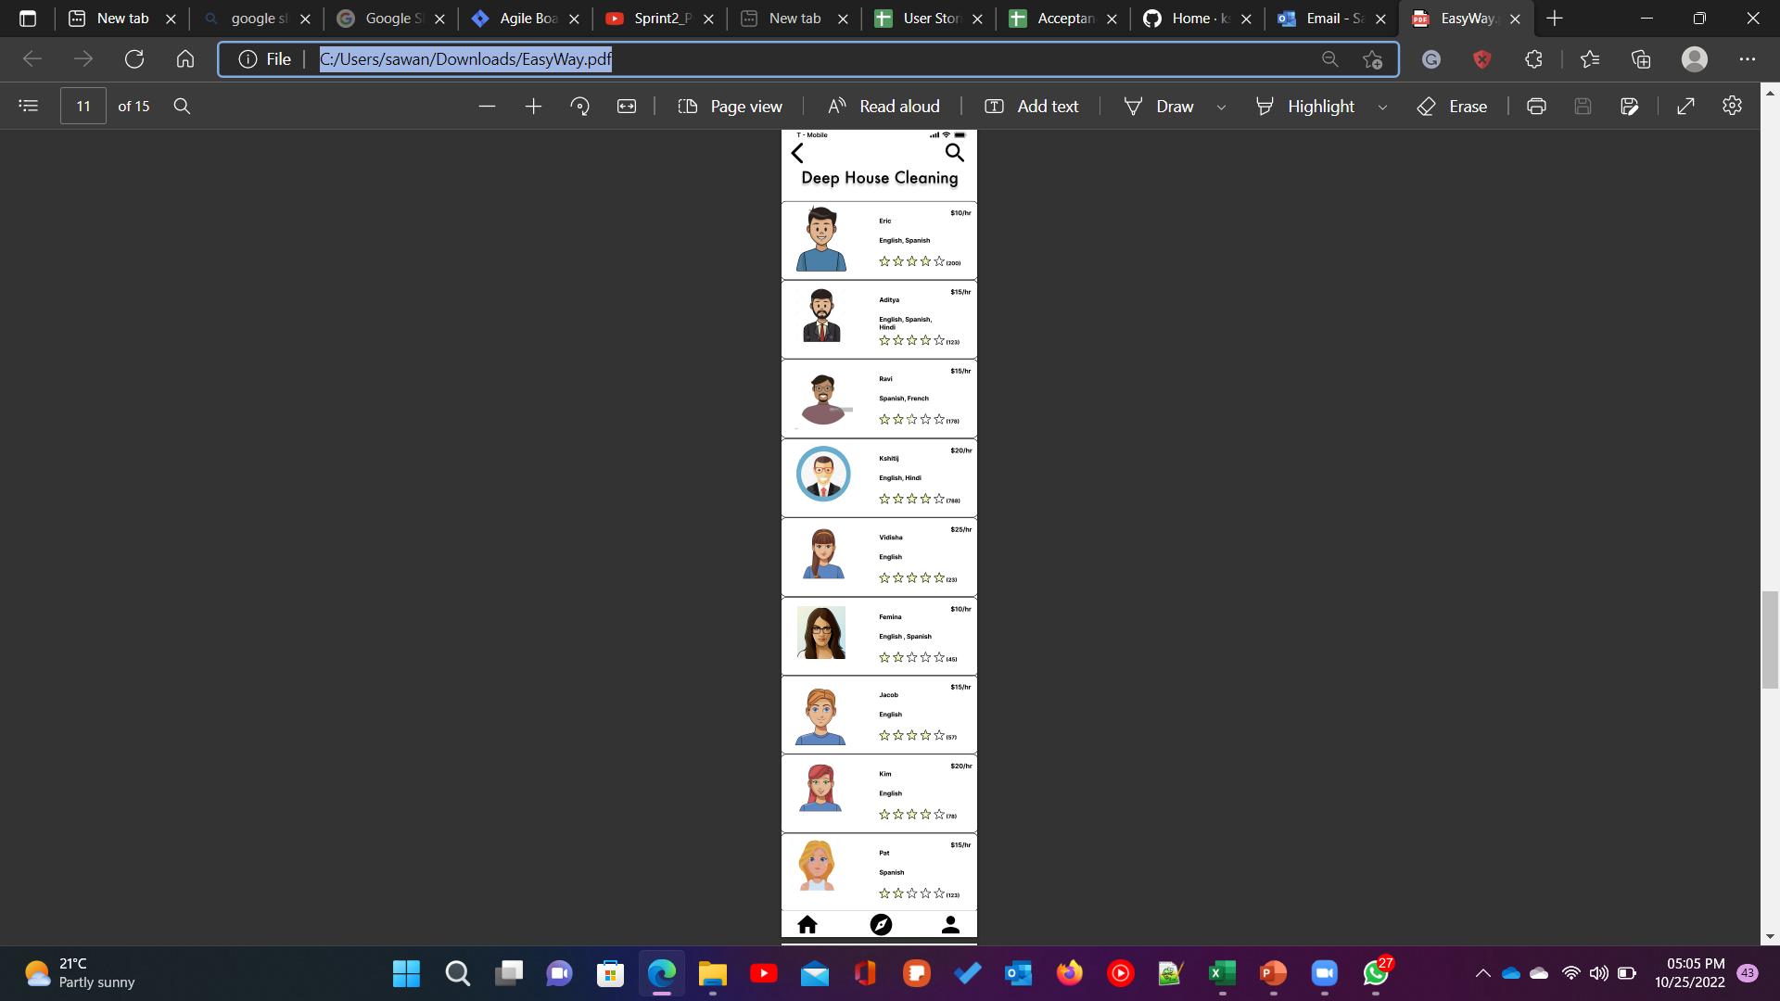
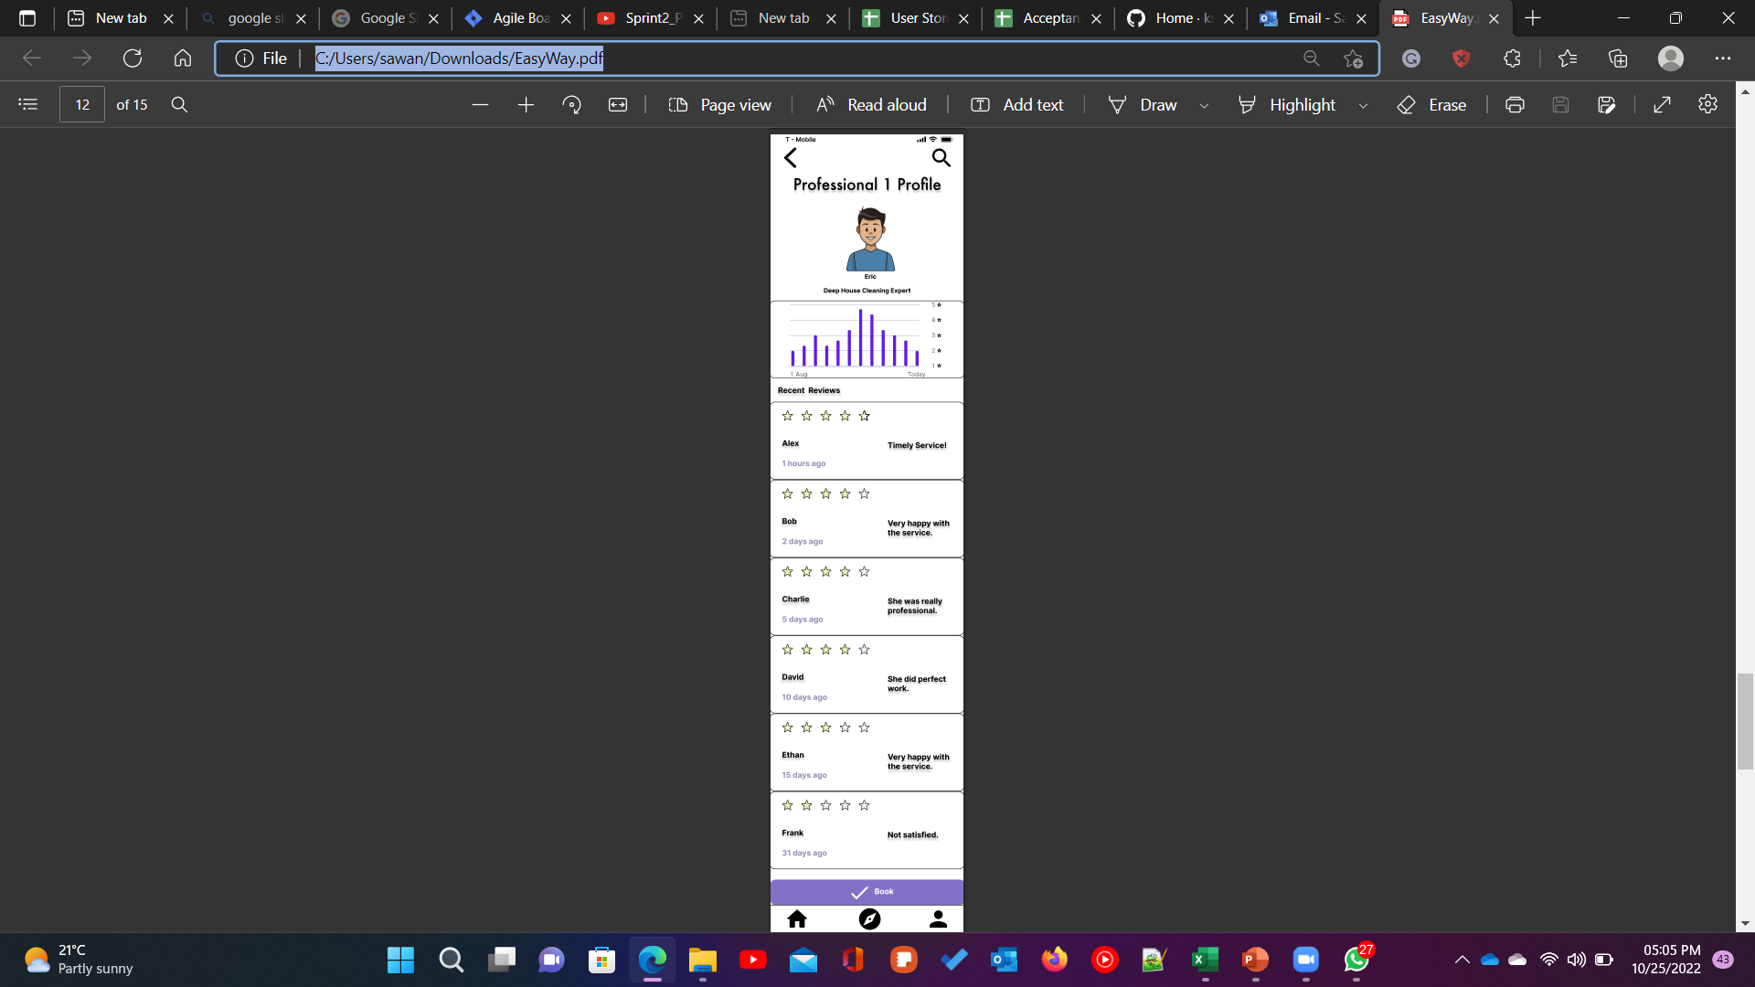
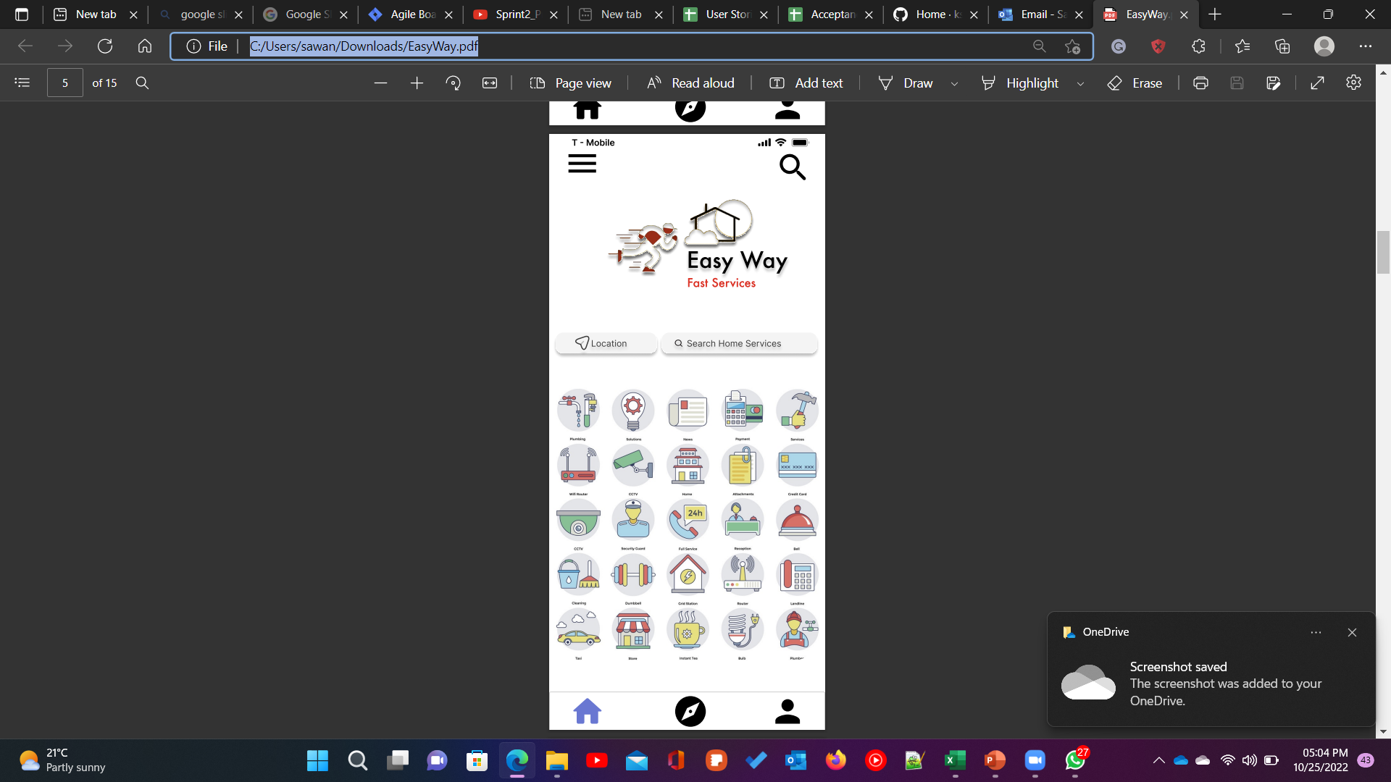
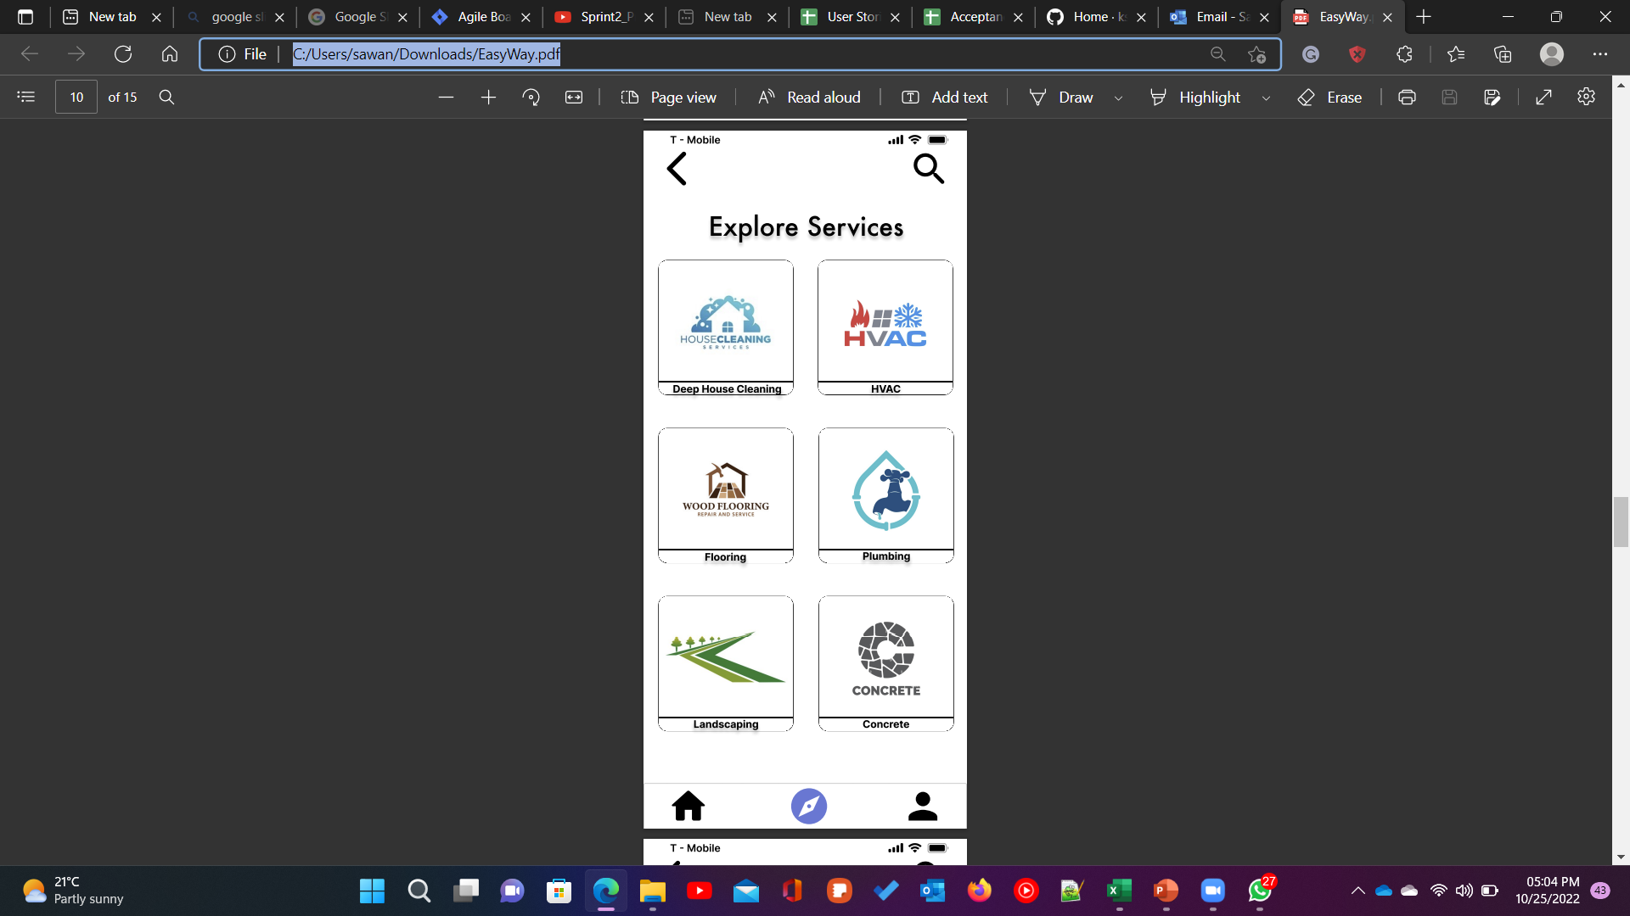
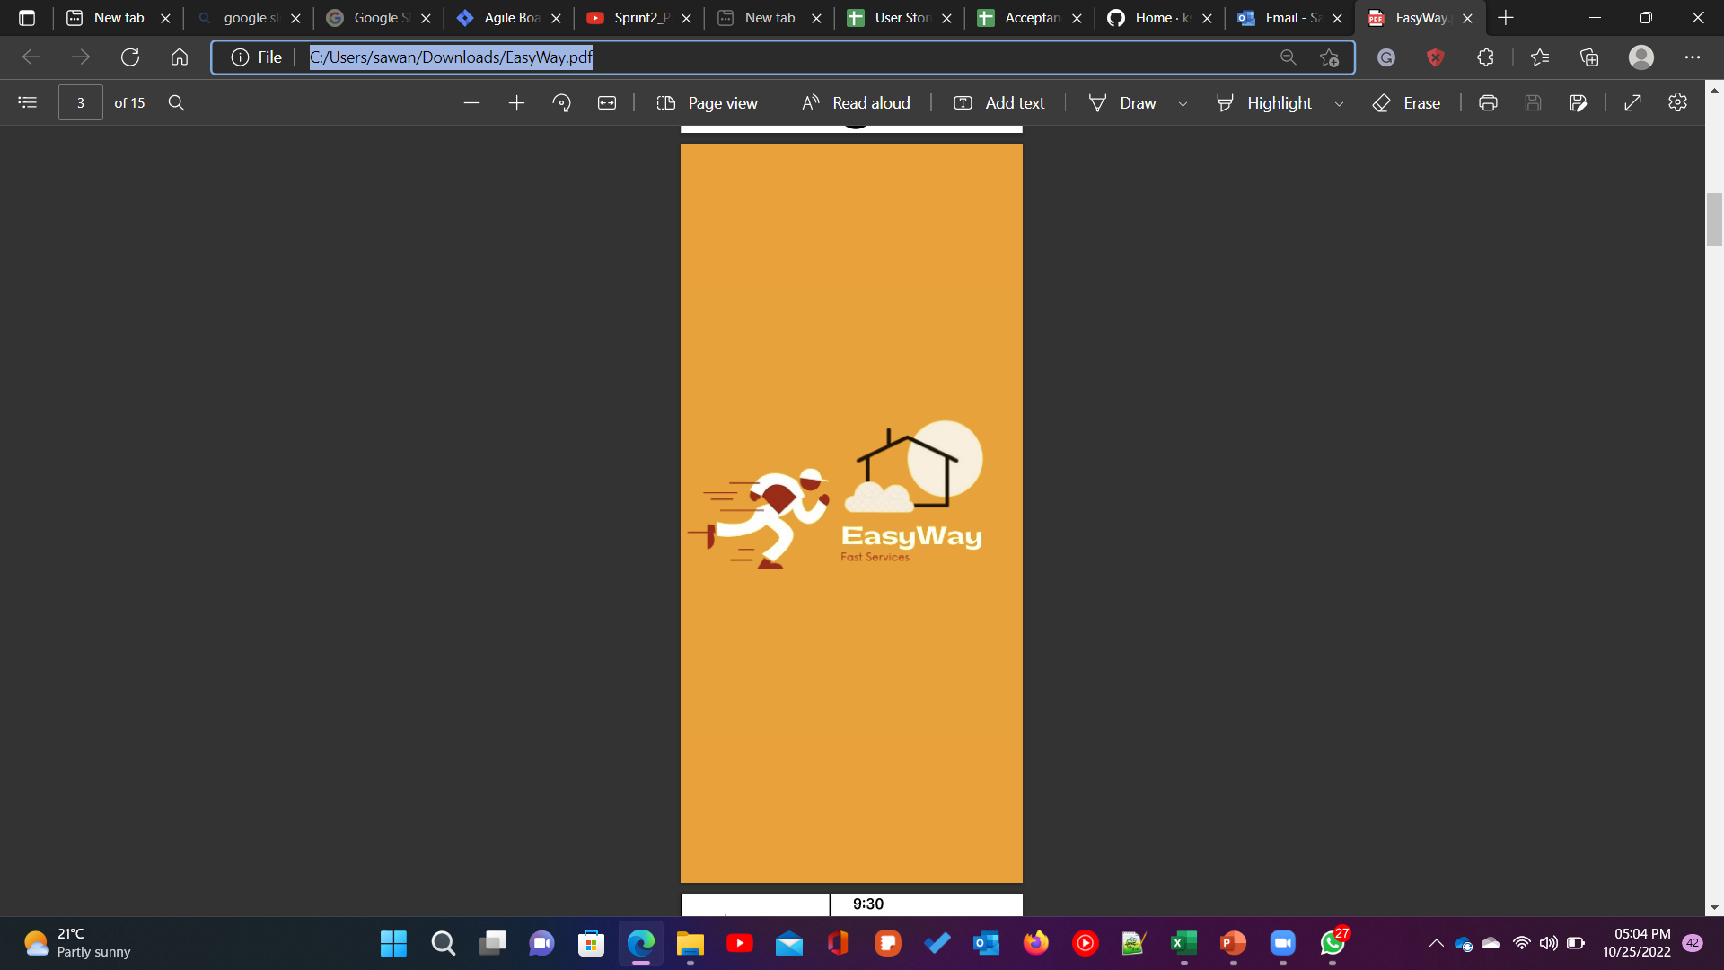
Minimal Viable Product (MVP)

Slide 15
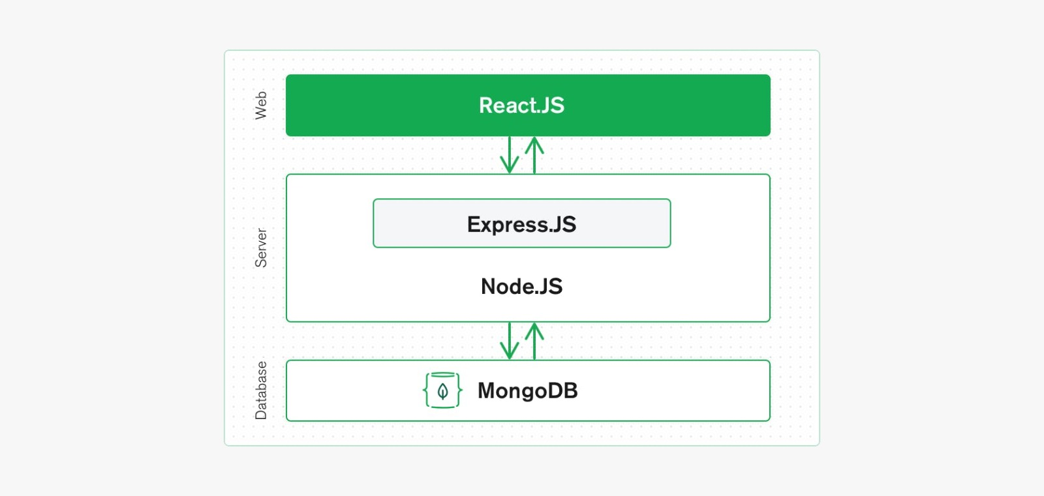
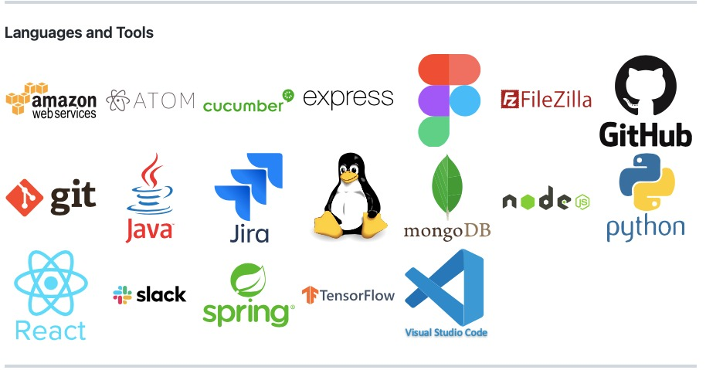
Technologies

Slide 16
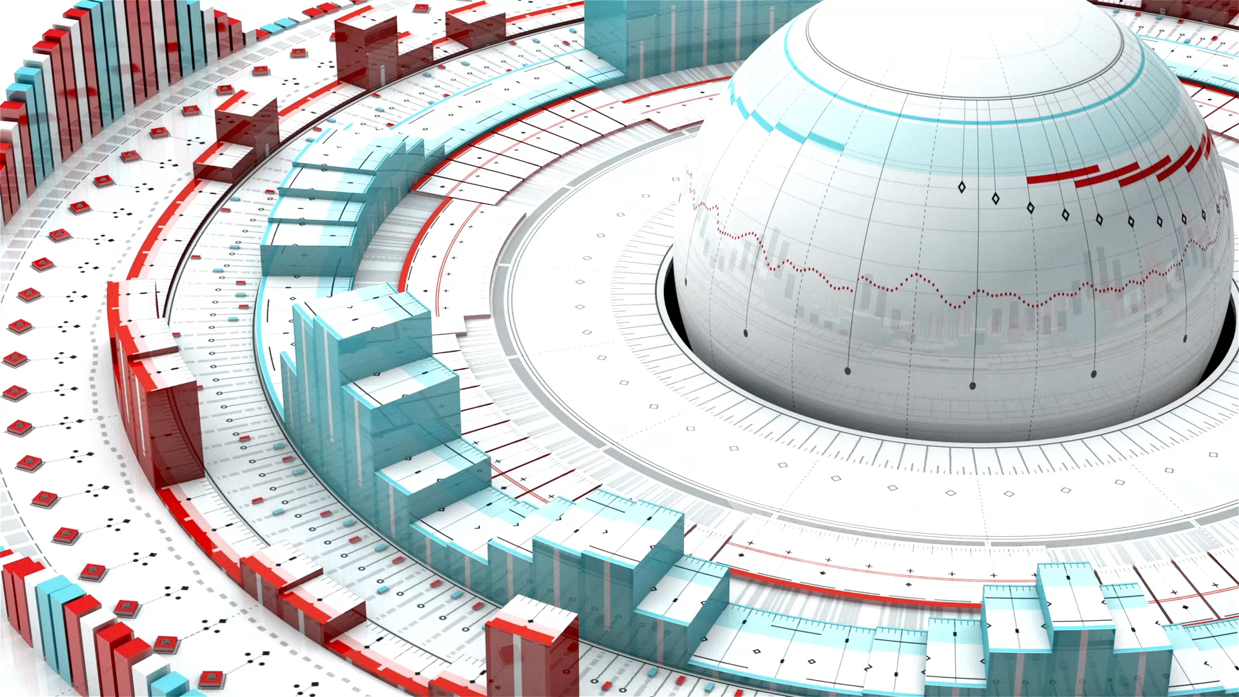
Architecture Diagram

Slide 17
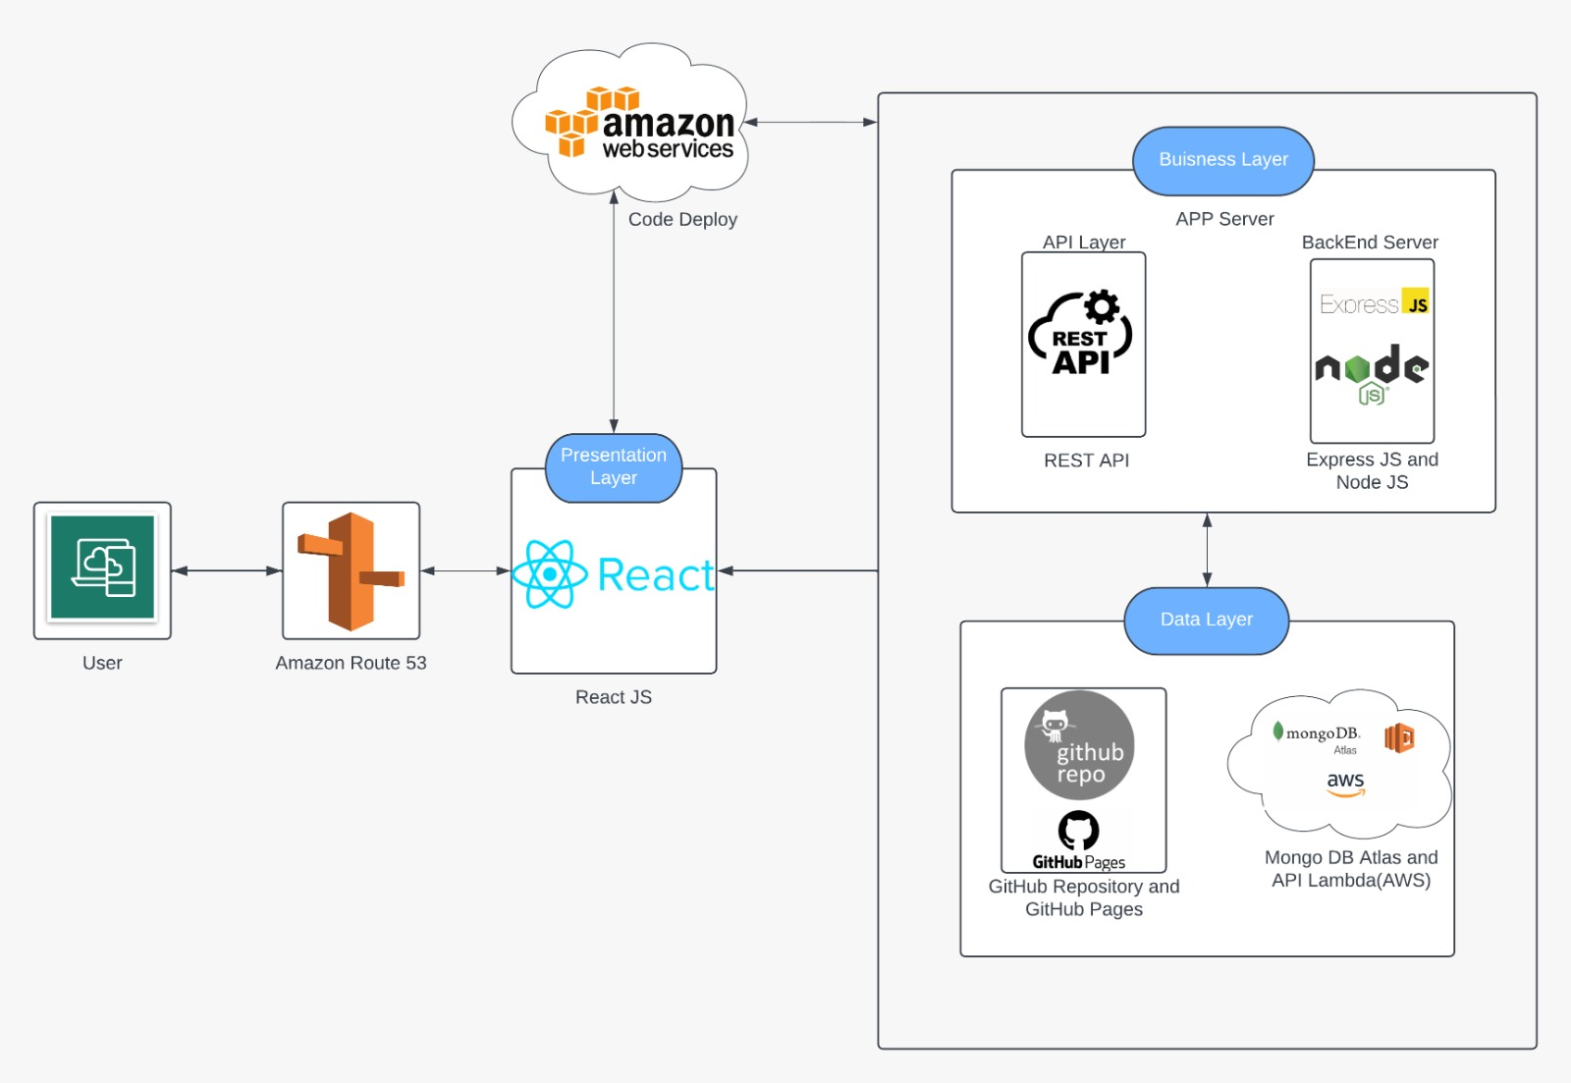
Conceptual Architecture Diagram

Slide 18
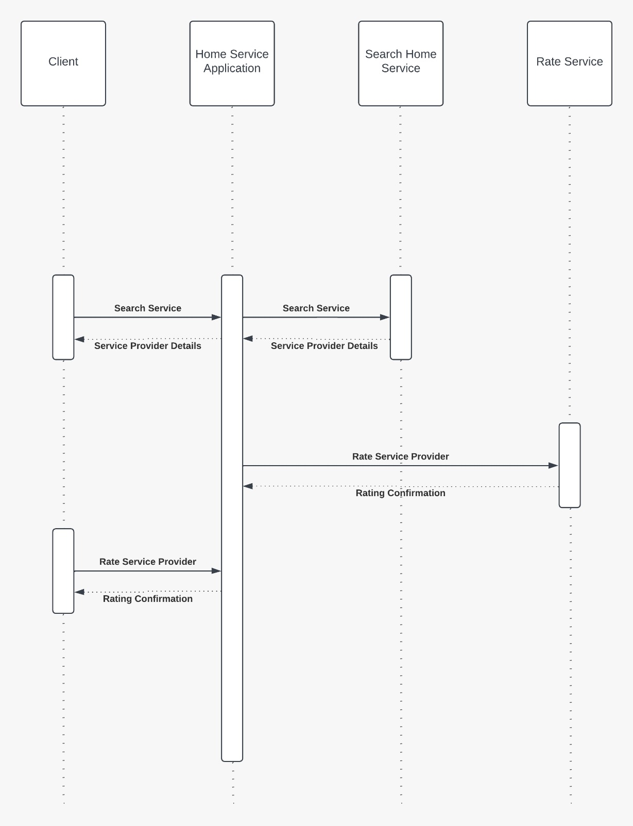
Sequence Architecture Diagram

Slide 19

Product backlog

Slide 20
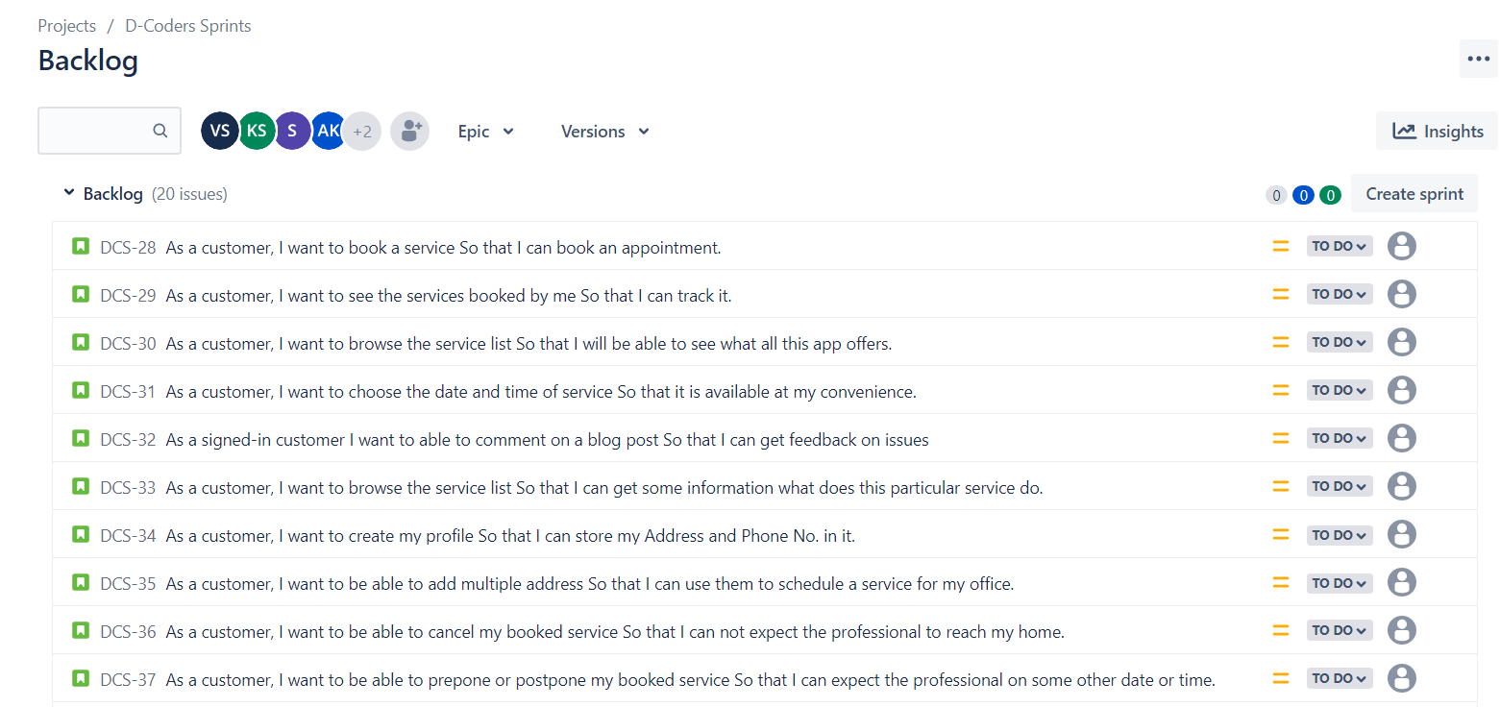
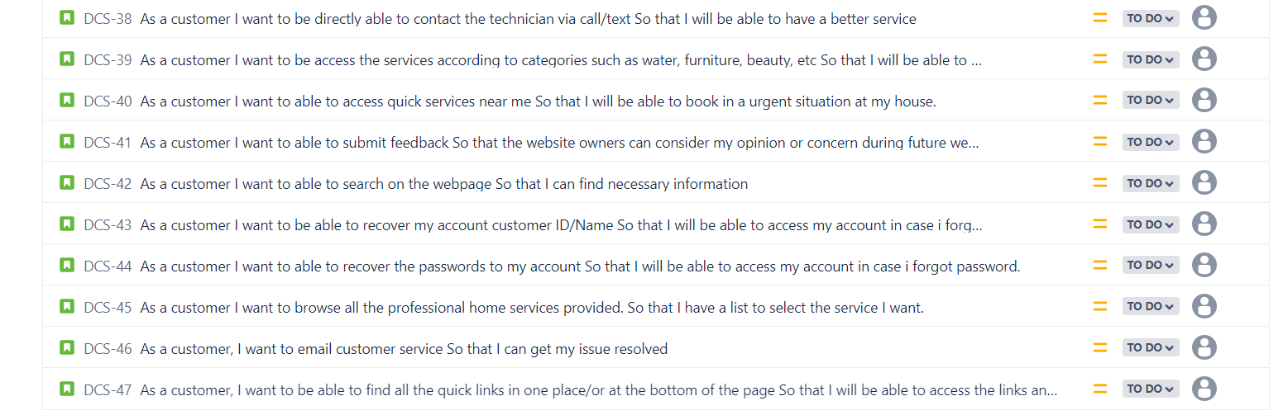
Product backlog

Slide 21
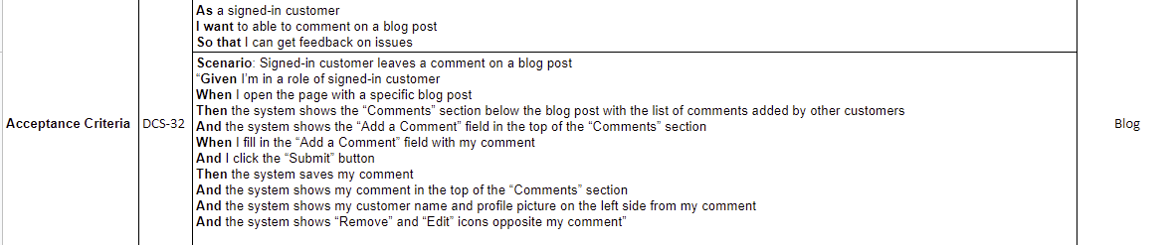
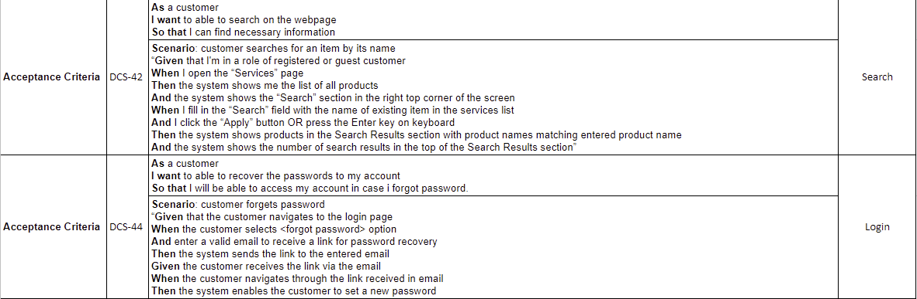
Acceptance Criteria & User stories

Slide 22
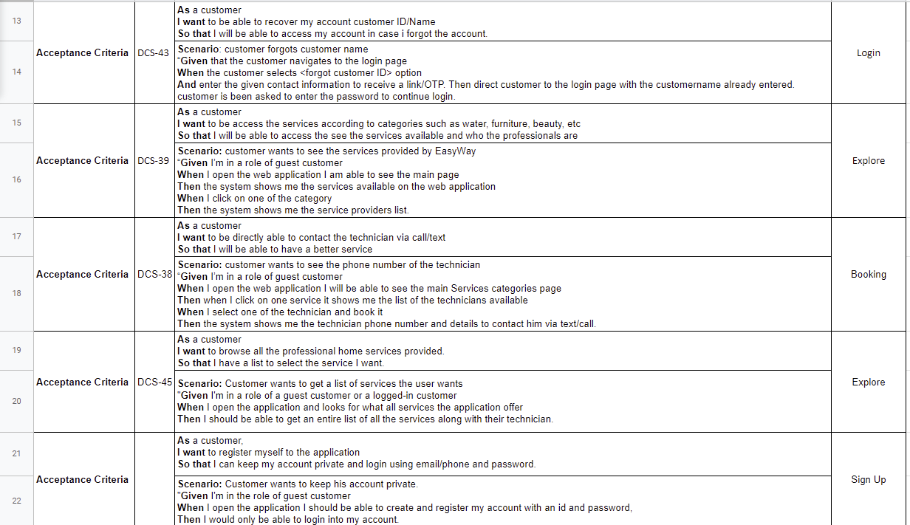
Acceptance Criteria & User stories

Slide 23
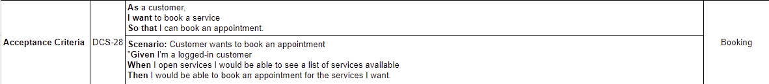
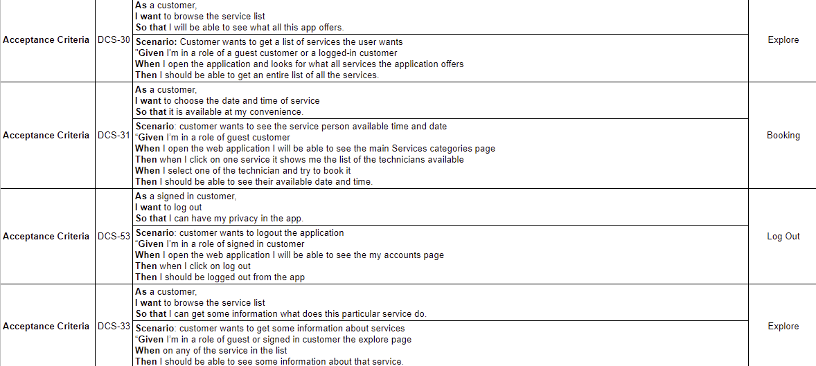
Acceptance Criteria & User stories

Slide 24
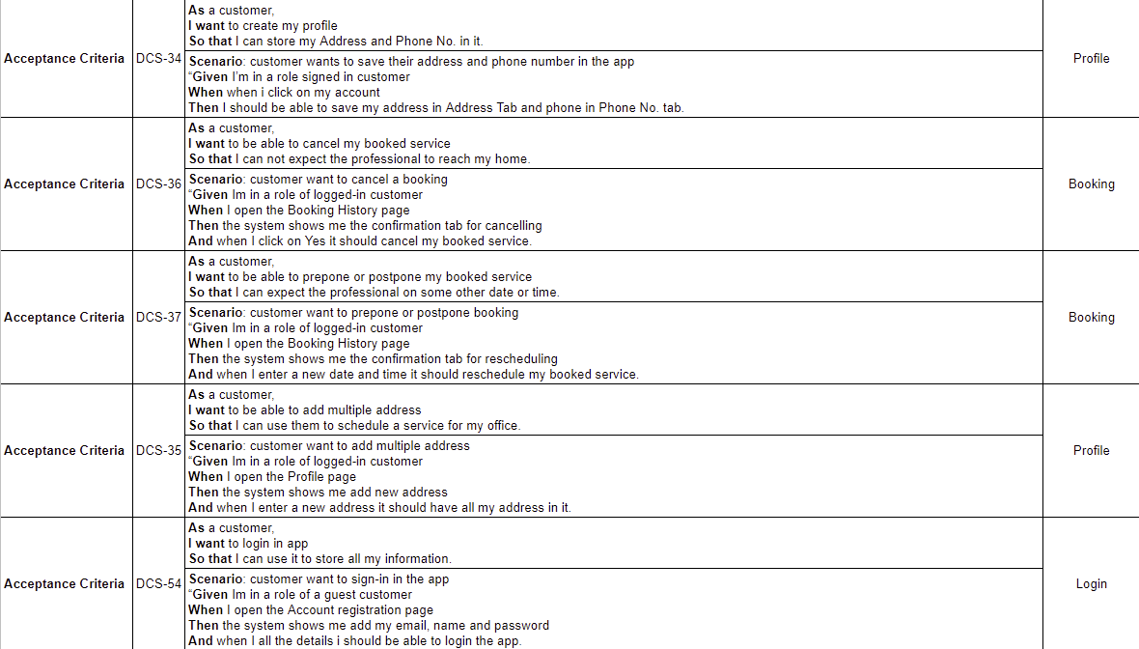
Acceptance Criteria & User stories

Slide 25
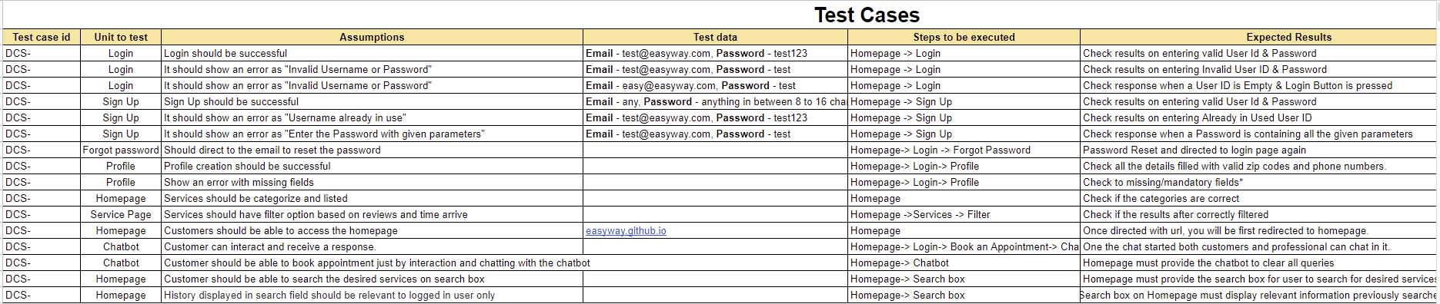
Test Cases

Slide 26
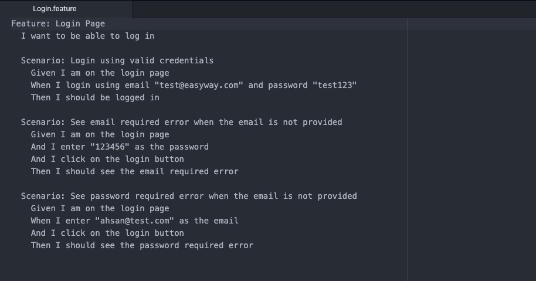
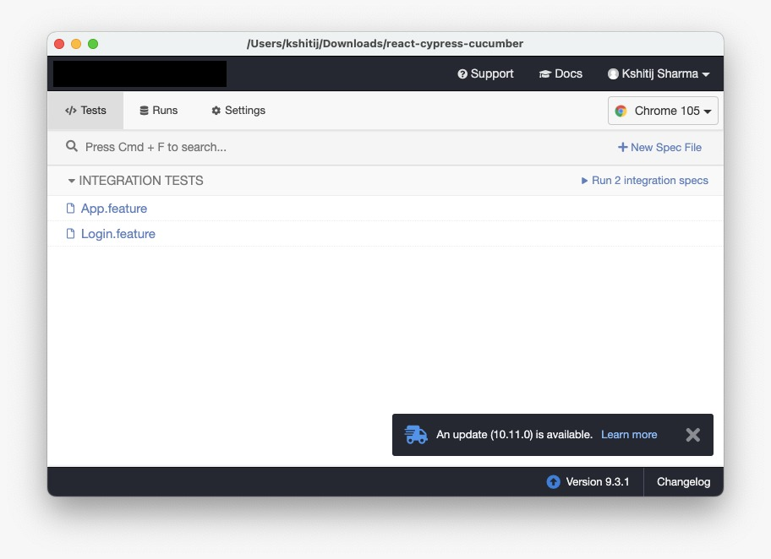
Cypress – cucumber Test

Slide 27

Sprint backlog

Slide 28
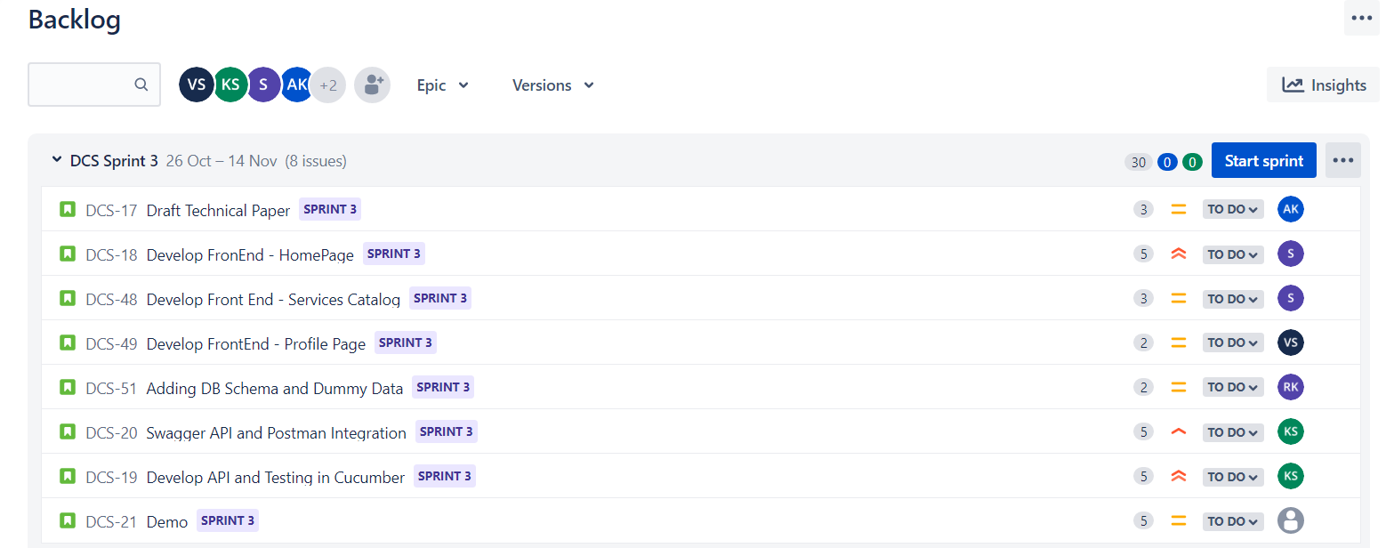
Sprint backlog
Sprint 3

Slide 29
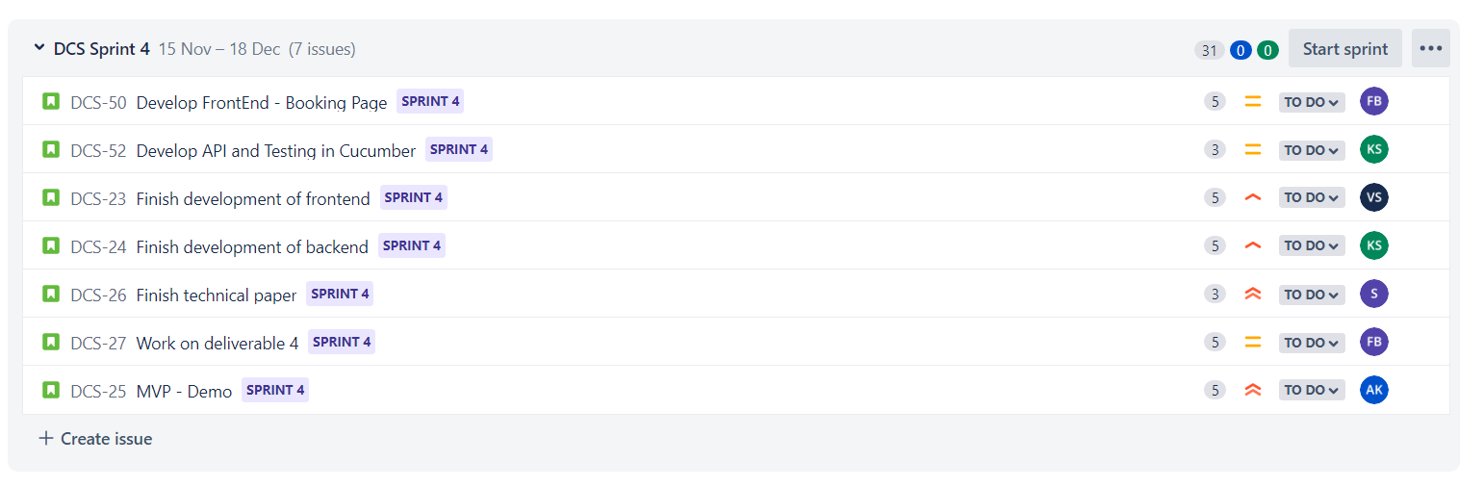
Sprint backlog
Sprint 4

Slide 30
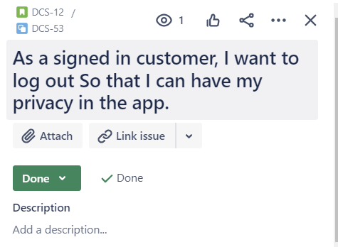
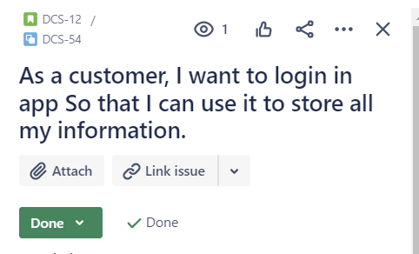
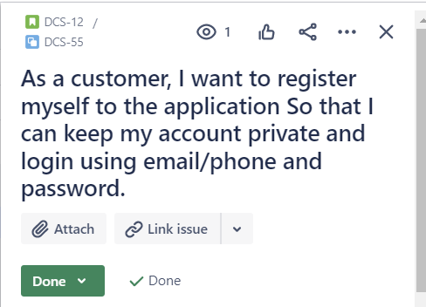
Stories Completed

Slide 31
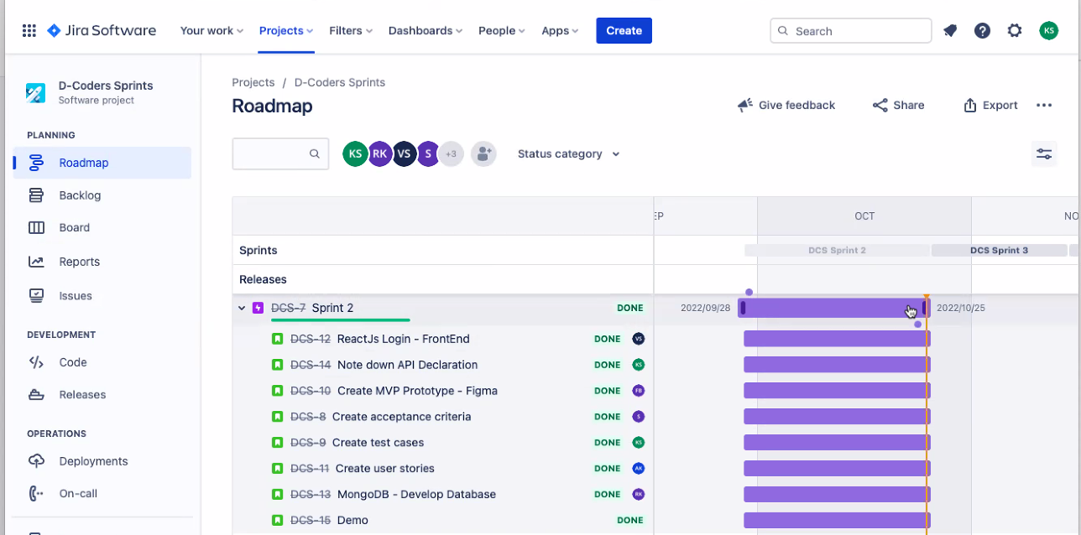
Sprint 2 Schedule

Slide 32

Metrics

Slide 33
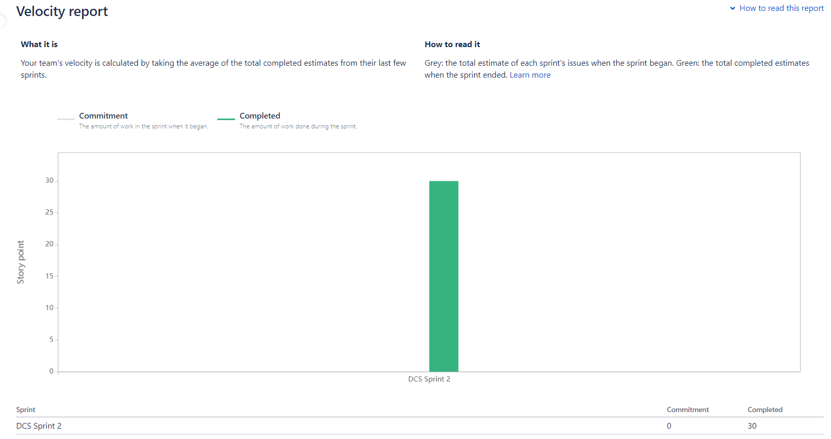
Metrics
Velocity report

Slide 34
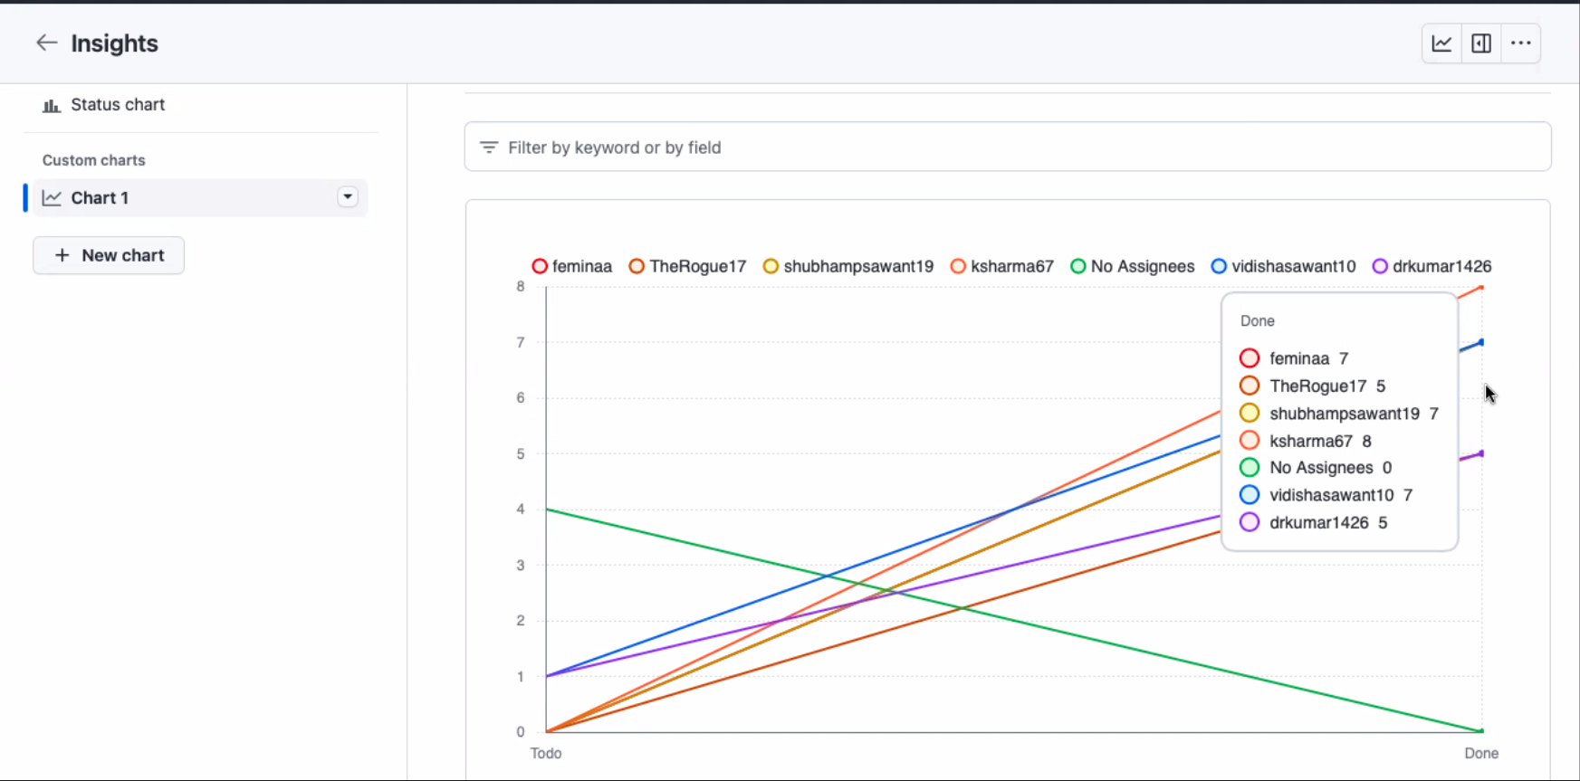
Team Members Velocity report

Slide 35
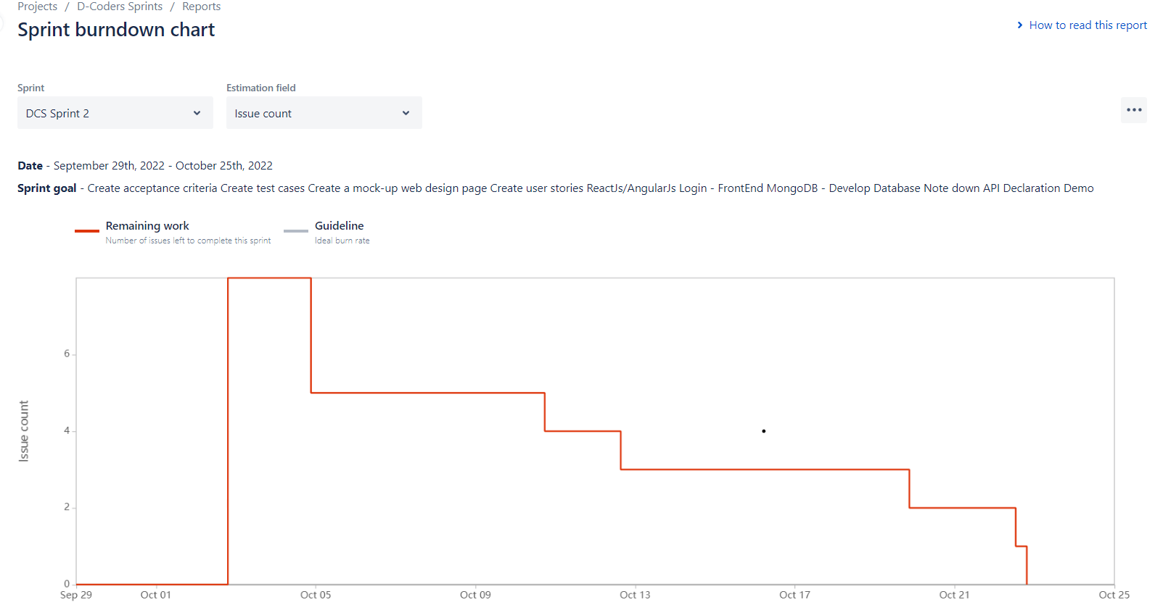
Metrics
Sprint Burndown Chart

Slide 36
Retrospective
Now while using slack as our daily driver, we are getting any updates which is made in Jira and Github as a slack notification.
What Went Well
Submission of a particular user story should be done on the given date. There was a lot of late submission done this time.
What needs improvement
During our weekly meeting we can ask everyone to give a quick summary of what they've been working on.
Next Steps

Slide 37
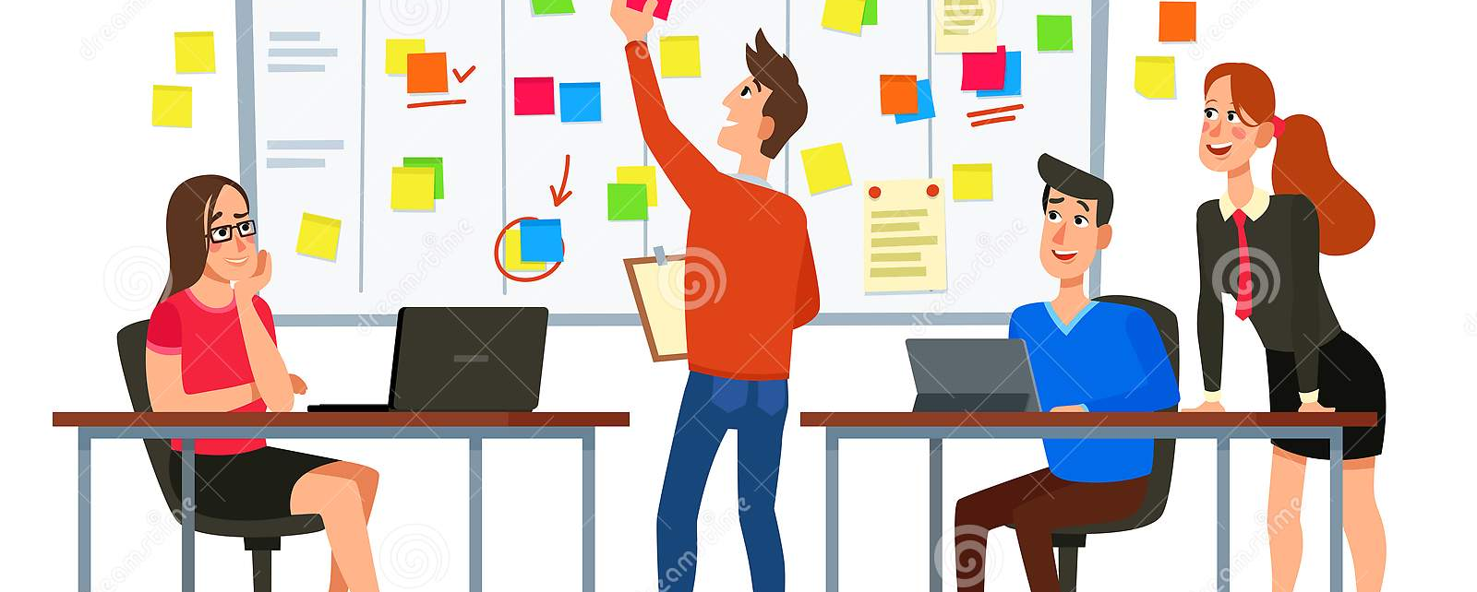
Sprint 3

Slide 38
Sprint 3

Slide 39
Stories planned and committed for sprint 3

Slide 40
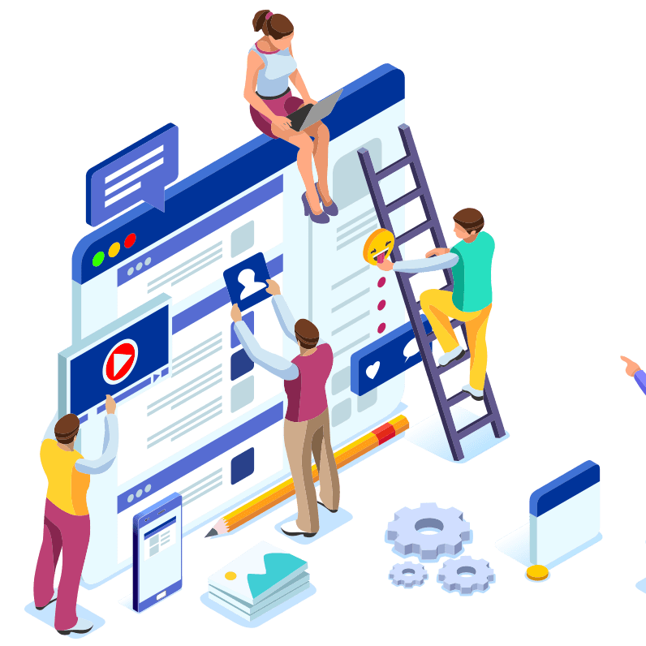
Project Demo Sprint 2

Slide 41
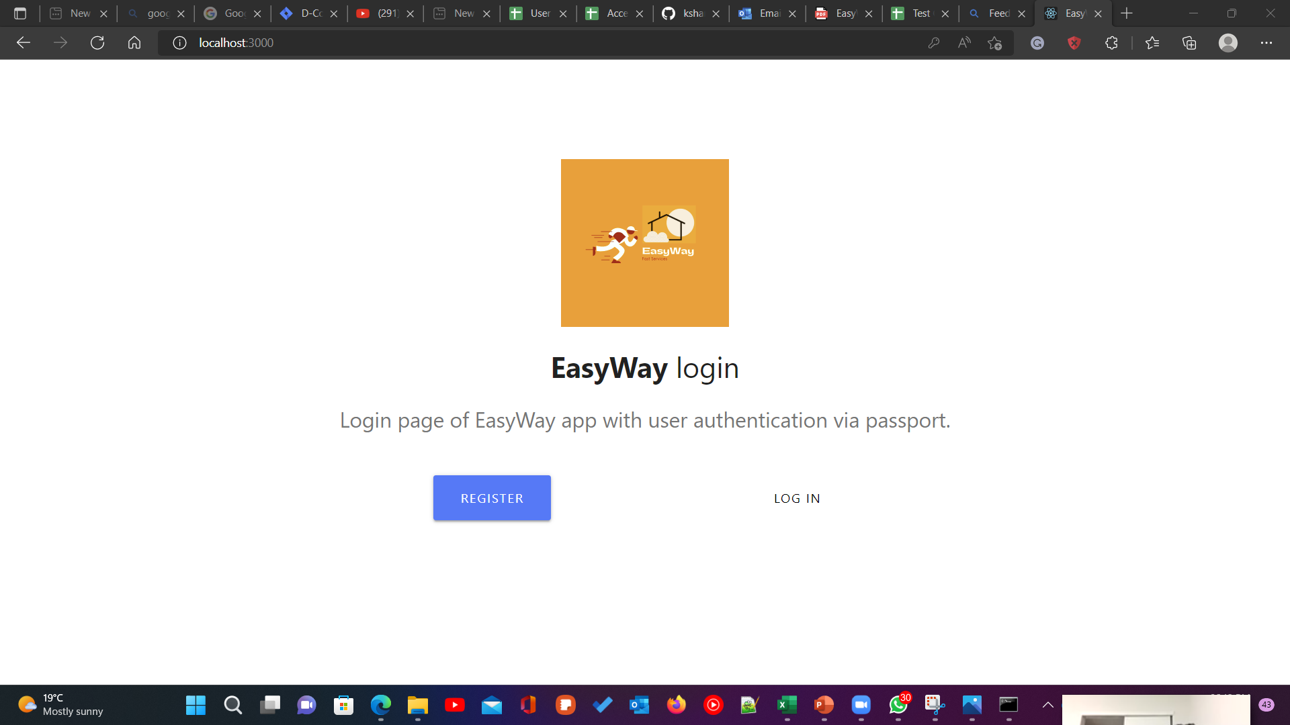
Project Demo – Sprint 2
Web Application Screenshots

Slide 42
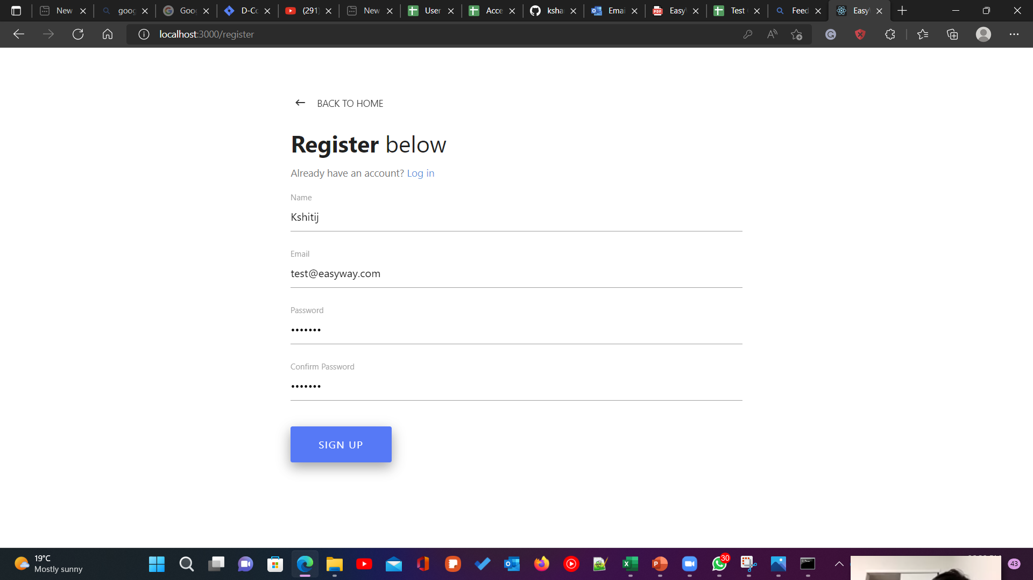
Project Demo – Sprint 2
Web Application Screenshots

Slide 43
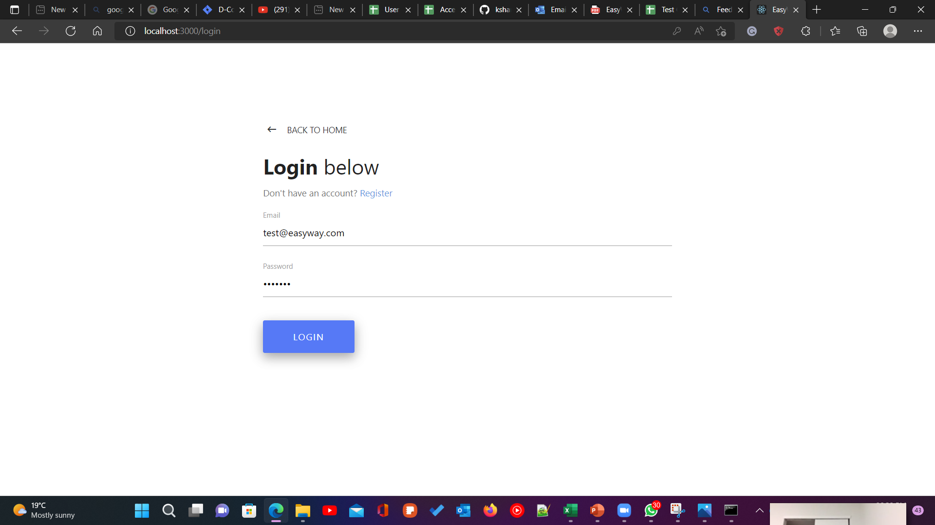
Project Demo – Sprint 2
Web Application Screenshots

Slide 44
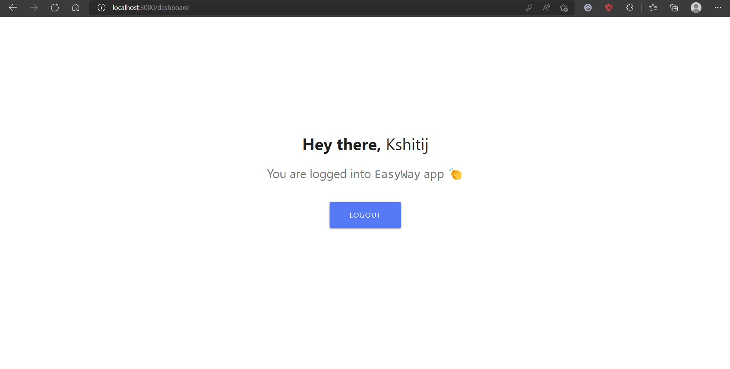
Project Demo – Sprint 2
Web Application Screenshots

Slide 45
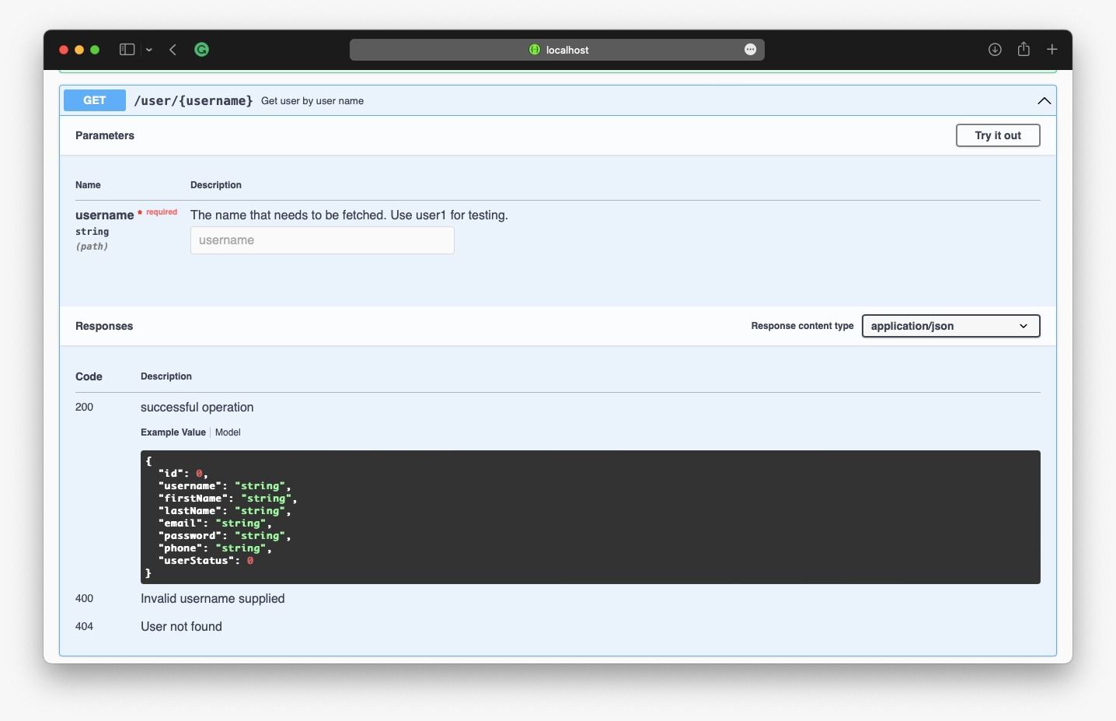
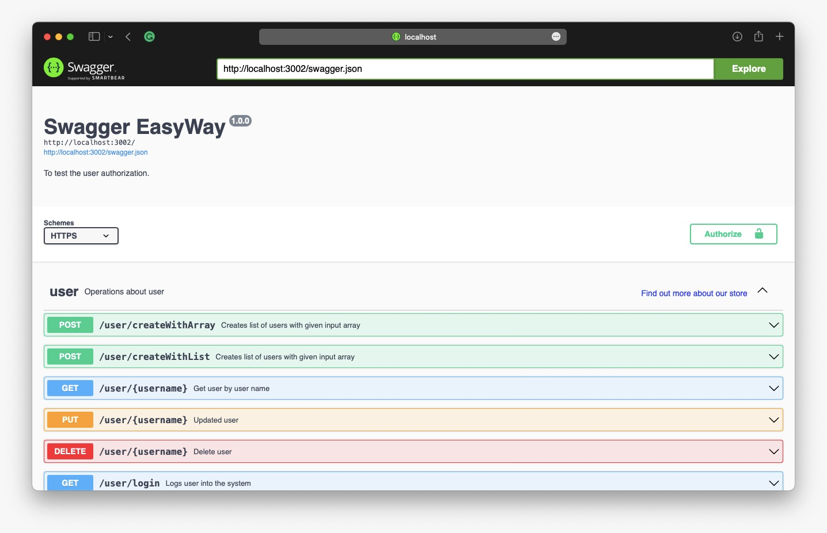
Project Demo – Sprint 2
API Screenshots

Slide 46
GitHub Link
Home · ksharma67/EasyWay Wiki (github.com)

Slide 47
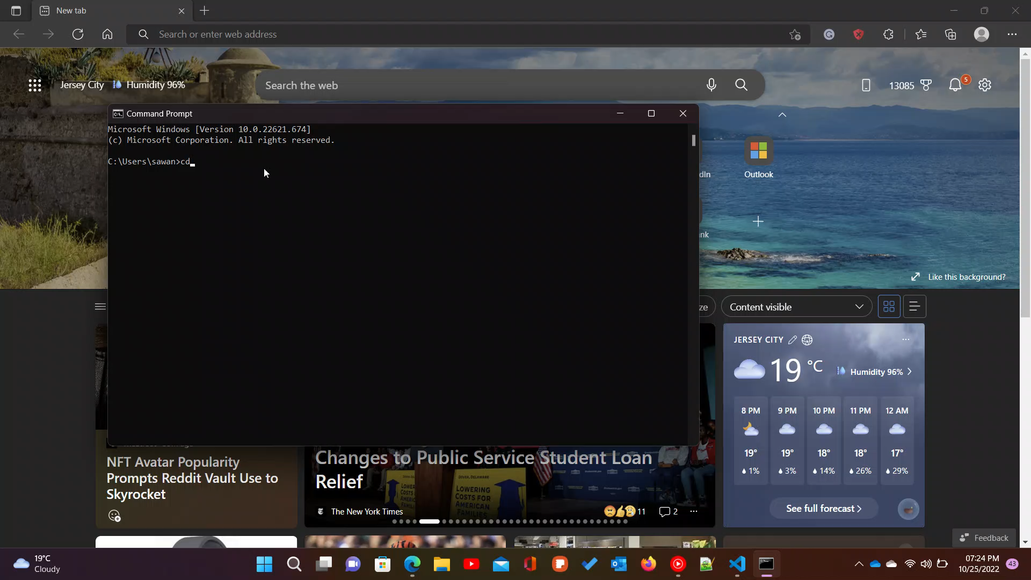
Live Application Demo

Slide 48

Thank you!

